Slide 1
CPSC3300: Computer Systems Organization
Lecture 16 – Real Processor Design Examples

Slide 2
Administrivia
Next lecture
Organization of system memory
Homework 4 now available
Homework 4 due 11:59pm Thursday 3/25
Project 2 due 11:59pm Friday 4/2
Exam 2
In class on Tuesday 3/30
Covers material introduced by today (Lecture 16 – Real Processor Design Examples)

Slide 3
Overview
Power efficiency
Pipeline and performance of ARM and Intel processors
Performance impact of optimization
Fallacies and pitfalls
Reading
Chp. 4.11 – 4.14

Slide 4
Power Efficiency
Complexity of dynamic scheduling and speculations requires power
Multiple simpler cores may be better
Microprocessor | Year | Clock Rate | Pipeline Stages | Issue width | Out-of-order/ Speculation | Cores | Power
i486 | 1989 | 25MHz | 5 | 1 | No | 1 | 5W
Pentium | 1993 | 66MHz | 5 | 2 | No | 1 | 10W
Pentium Pro | 1997 | 200MHz | 10 | 3 | Yes | 1 | 29W
P4 Willamette | 2001 | 2000MHz | 22 | 3 | Yes | 1 | 75W
P4 Prescott | 2004 | 3600MHz | 31 | 3 | Yes | 1 | 103W
Core | 2006 | 2930MHz | 14 | 4 | Yes | 2 | 75W
UltraSparc III | 2003 | 1950MHz | 14 | 4 | No | 1 | 90W
UltraSparc T1 | 2005 | 1200MHz | 6 | 1 | No | 8 | 70W

Slide 5
Cortex A8 and Intel i7
Processor | ARM A8 | Intel Core i7 920
Market | Personal Mobile Device | Server, cloud
Thermal design power | 2 Watts | 130 Watts
Clock rate | 1 GHz | 2.66 GHz
Cores/Chip | 1 | 4
Floating point? | No | Yes
Multiple issue? | Dynamic | Dynamic
Peak instructions/clock cycle | 2 | 4
Pipeline stages | 14 | 14
Pipeline schedule | Static in-order | Dynamic out-of-order with speculation
Branch prediction | 2-level | 2-level
1st level caches/core | 32 KiB I, 32 KiB D | 32 KiB I, 32 KiB D
2nd level caches/core | 128-1024 KiB | 256 KiB
3rd level caches (shared) | - | 2- 8 MB

Slide 6
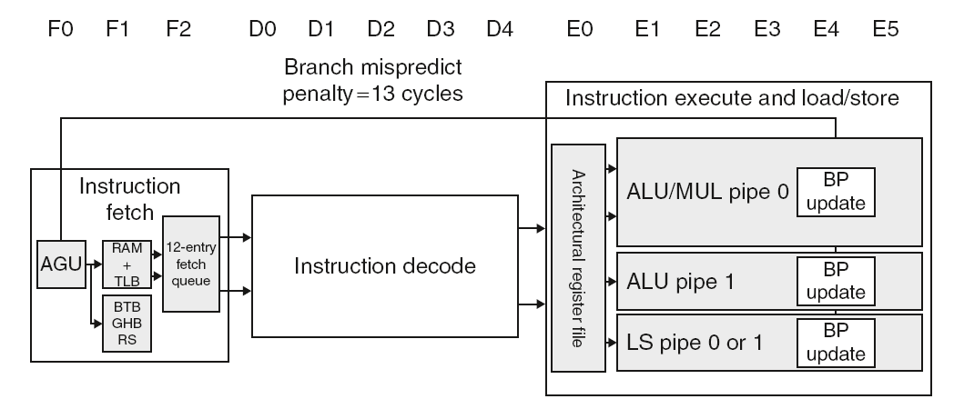
ARM Cortex-A8 Pipeline

Slide 7
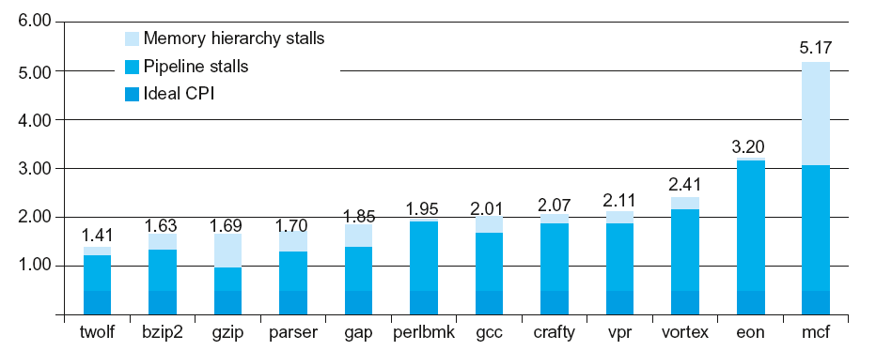
ARM Cortex-A8 Performance

Slide 8
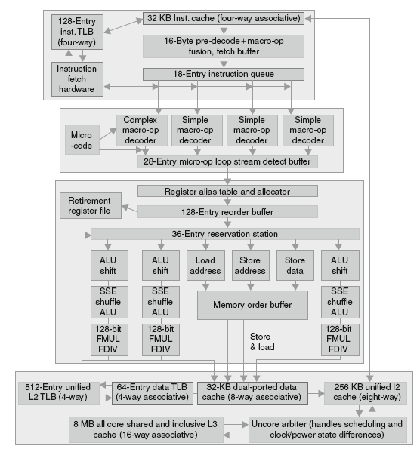
Core i7 Pipeline

Slide 9
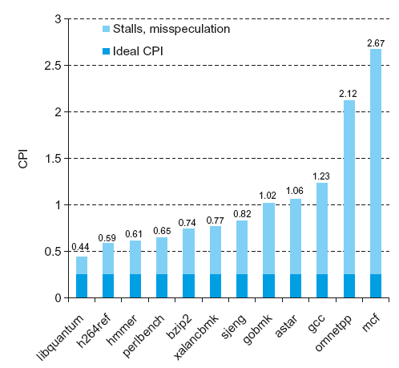
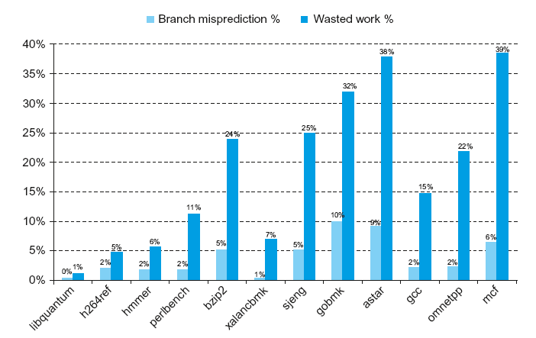
Core i7 Performance

Slide 10
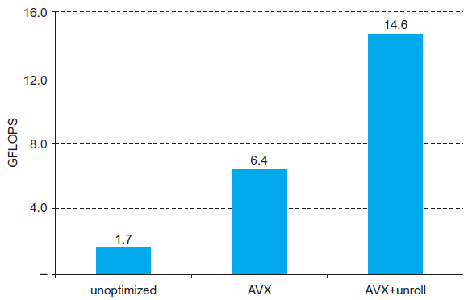
Performance Impact of Optimization
Performance of DGEMM (matrix multiplication) for 32x32 matrices with optimization techniques
AVX: vectorization / SIMD
unroll: loop unrolling - fewer pipeline stalls and allows for more instruction level parallelism

Slide 11
Fallacies
Pipelining is easy (!)
The basic idea is easy
The devil is in the details
e.g., detecting data hazards
Pipelining is independent of technology
So why haven’t we always done pipelining?
More transistors make more advanced techniques feasible
Pipeline-related ISA design needs to take account of technology trends
e.g., predicated instructions

Slide 12
Pitfalls
Poor ISA design can make pipelining harder
e.g., complex instruction sets (VAX, IA-32)
Significant overhead to make pipelining work
IA-32 micro-op approach
e.g., complex addressing modes
Register update side effects, memory indirection
e.g., delayed branches
Advanced pipelines have long delay slots

